Slide 1
Java Server Faces 2 “Olá Mundo!”
Alexandre L’Erario
alerario@utfpr.edu.br

Slide 2
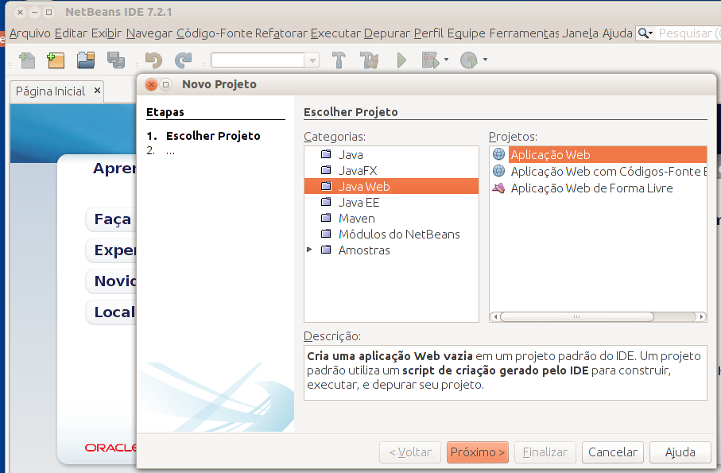
Criar um aplicativo Web JSF2
No NetBeans:
O Framework JSF2 pode ser adicionado ao projeto
O projeto pode ser criado com o Framework JSF2

Slide 3
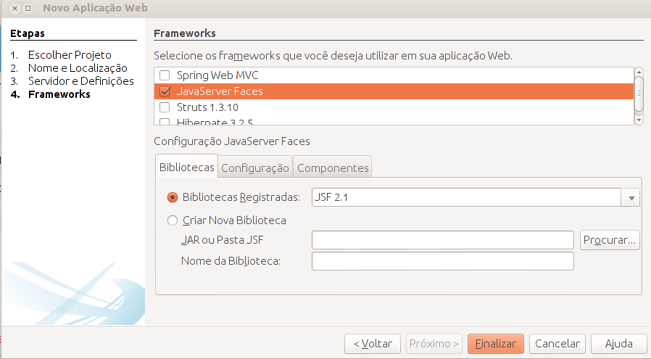
Adicionar o framework JSF

Slide 4
index.xhtml
<?xml version='1.0' encoding='UTF-8' ?>
<!DOCTYPE html PUBLIC "-//W3C//DTD XHTML 1.0 Transitional//EN" "http://www.w3.org/TR/xhtml1/DTD/xhtml1-transitional.dtd">
<html xmlns="http://www.w3.org/1999/xhtml"
xmlns:h="http://java.sun.com/jsf/html">
<h:head>
<title>Facelet Title</title>
</h:head>
<h:body>
Hello from Facelets
</h:body>
</html>

Slide 5
Após reendenização
<?xml version='1.0' encoding='UTF-8' ?> <!DOCTYPE html PUBLIC "-//W3C//DTD XHTML 1.0 Transitional//EN" "http://www.w3.org/TR/xhtml1/DTD/xhtml1-transitional.dtd"> <html xmlns="http://www.w3.org/1999/xhtml">
<head>
<title>Facelet Title</title>
</head>
<body> Hello from Facelets </body>
</html>

Slide 6

Analisar o servidor

